Slide 1
TOPIC B3:
OBJECT ORIENTED PROGRAMMING
LESSON B3-1
FUNDAMENTALS OF OOP

Slide 2
AGENDA
Fundamentals of OOP
Classes
Objects
Advantages/Disadvantages of OOP
UML Diagrams
Designing Classes/Functions
NOTE!
Have a way to take notes and a way to write code available for this lesson

Slide 3

THE WARM UP QUESTION
Define the following terms:
Variable
Function

Slide 4
THE WARM UP ANSWER
Variable – named storage location that holds a value or data
Function – block of code designed to perform a specific task. Used to create reusable, modular code

Slide 5
WHAT IS OOP?
Object Oriented Programming (OOP) – a paradigm in computer science that increases modularity with a new type of
ABSTRACTION

Slide 6
CLASSES
OOP allows us to standardize the structure of data in a program by making CUSTOM DATA TYPES
Classes – custom data types that we define
We are no longer limited to integers, strings, and floats
Data types such as: Person, Book, BankAccount, ShoppingBasket

Slide 7
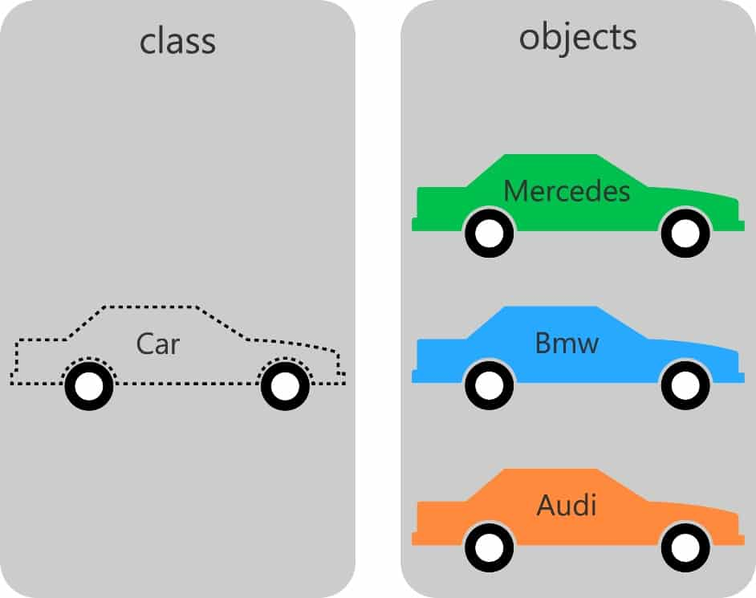

OBJECTS
Object – a specific instance of a class
This is when we create a variable based on our data type
If our class is Car, the object based on that (Toyota Corolla, Honda CRV, etc.) is our Object
You can make multiple objects based on one class
In this way, classes function as blueprints for our objects

Slide 8
WHAT IS OOP?
Classes contain two things:
Variables: Data about the object
Functions: Things that the object can do

Slide 9
STRING EXAMPLE
Let’s look at a built in Python example: Strings
Strings are a class that Python develops for us to use
What data does a string store?
What functions can a string perform?

Slide 10
STRING EXAMPLE
Data:
Letters in the string
Length of string
Functions:
Split
Upper
Lower

Slide 11

ADVANTAGES
OOP is an INCREDIBLY powerful tool
You can see it in fields as far reaching as data analysis to game design
Let’s look at a couple of the things that OOP is really good for and good at

Slide 12
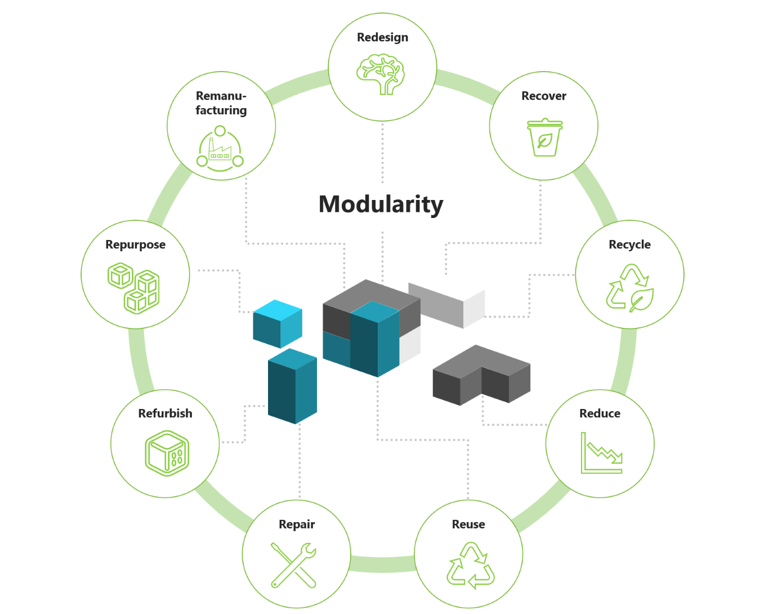
ADVANTAGES
Increased modularity – classes/objects can help to ensure that different parts of your program are using the same data and functions
Objects can be modified without modifying the code that uses them (pretty cool)
Diagram not required knowledge

Slide 13
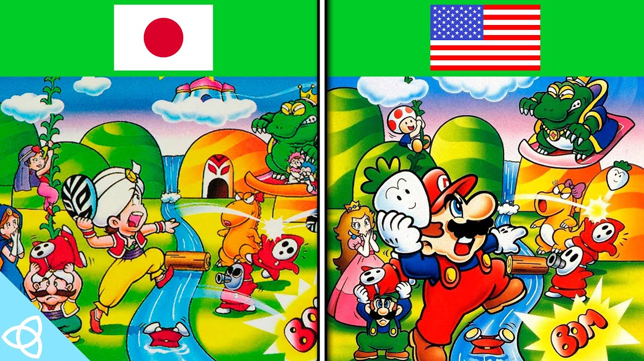
ADVANTAGES
Code reusability – once a class is written, it can even be used in other projects
This is the same concept as modularity

Slide 14

ADVANTAGES
Encapsulation – hides the internal mechanics of how a class works
Programmers only need to know how to use the class, not how it was made
Programmers trust the class to do what it needs to do, and that they don’t need to worry about it

Slide 15
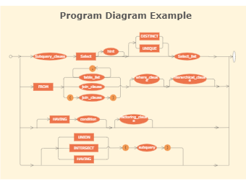
ADVANTAGES
Scale – because of modularity and reusability, OOP projects can get much larger while staying maintainable
Diagram not required knowledge

Slide 16
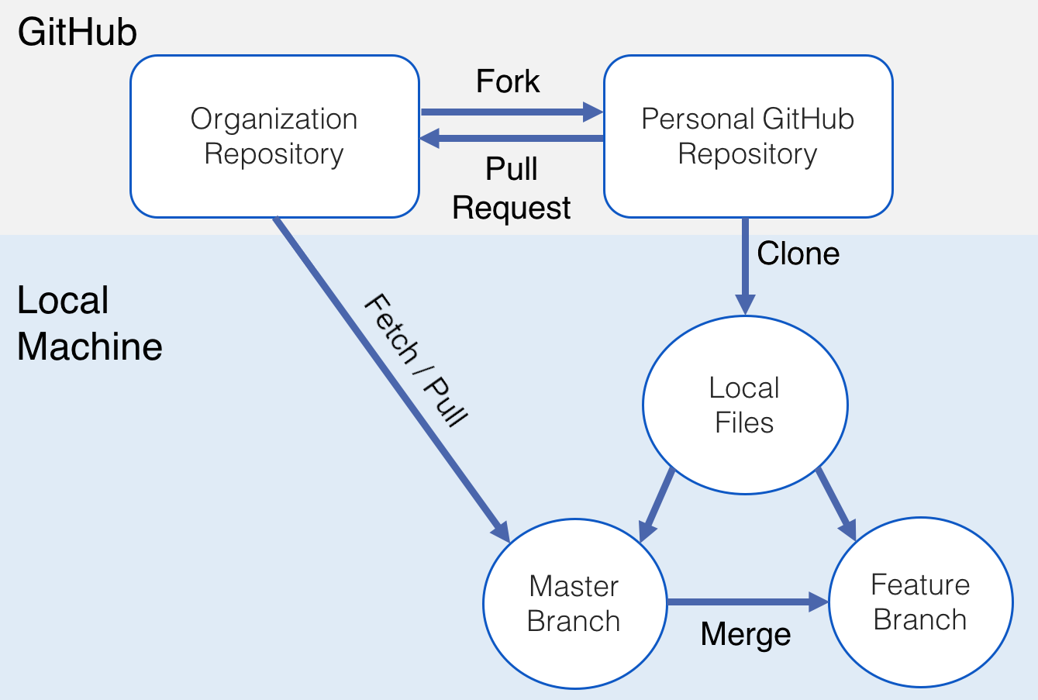
ADVANTAGES
Collaboration – because the program is modular, different people can work on different parts of the project, allowing for larger teams
Diagram not required knowledge

Slide 17
DISADVANTAGES
But, as I’m sure you’re all feeling right now, this is a lot of new information, and we don’t know how it all applies yet
Let’s look at some disadvantages of OOP next

Slide 18

DISADVANTAGES
Learning curve – OOP is hard man! For beginner programmers it can be difficult to understand

Slide 19
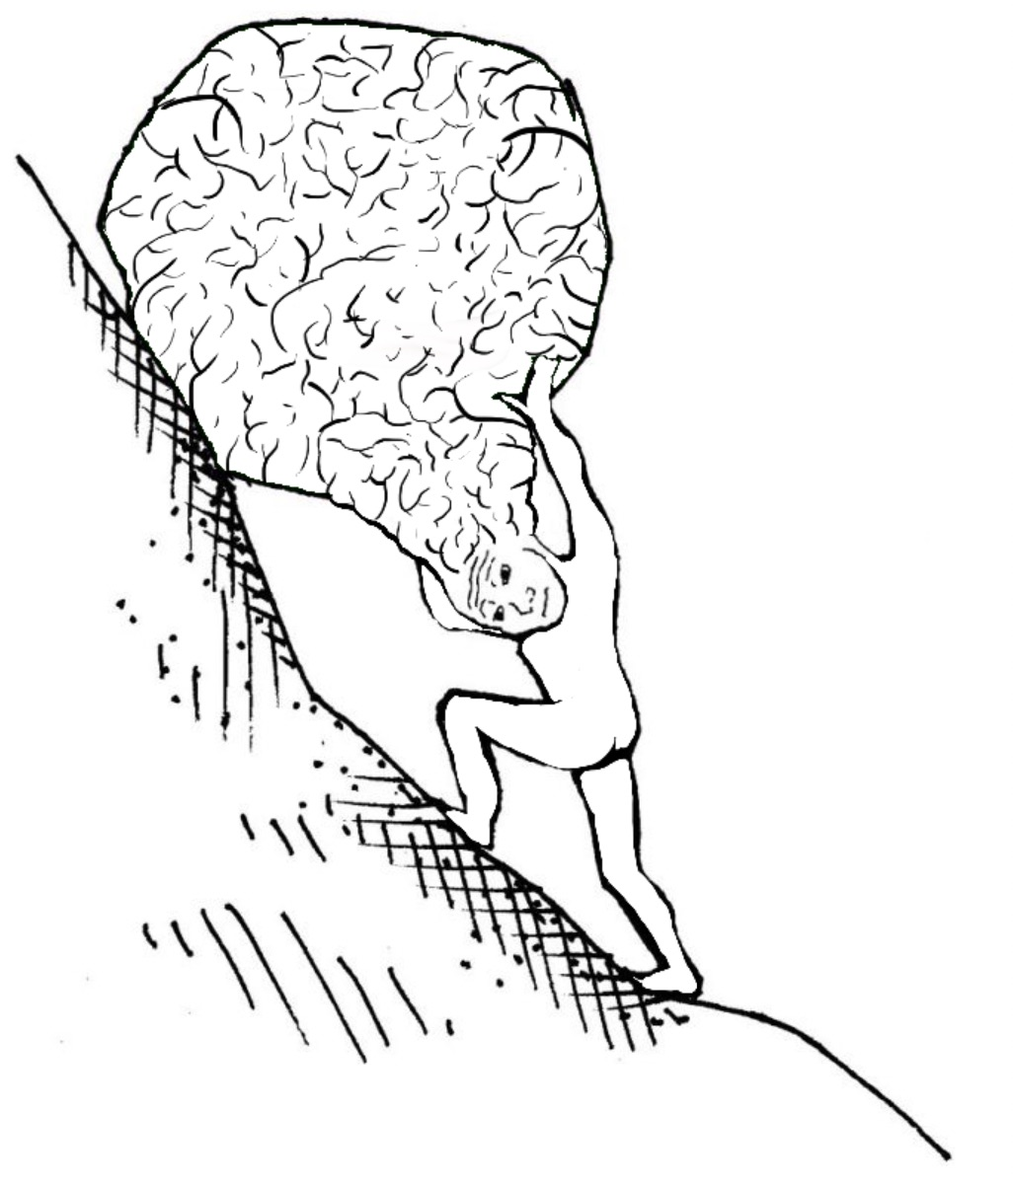
DISADVANTAGES
Increased Complexity – small programs don’t always need an OOP approach, sometimes a standard procedural one does the trick
OOP can also make programs much larger and harder to test/debug

Slide 20

DISADVANTAGES
Overuse – OOP is good at solving some problems, but not all problems
Some programmers try to do OOP for everything and it leads to bad code sometimes when it shouldn’t be used

Slide 21
DISADVANTAGES
Overhead – OOP increases the amount of space a program takes up, and the amount of time it takes to run

Slide 22
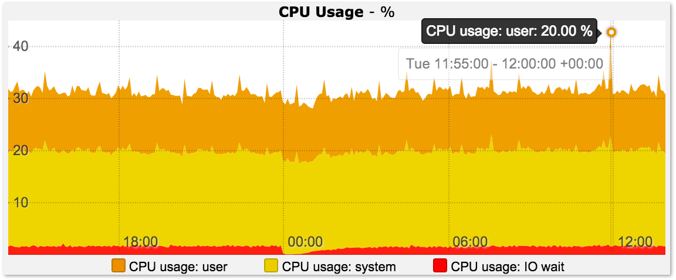
DISADVANTAGES
Lack of Optimization – The focus of OOP is providing abstraction, but that comes at the cost of being way less efficient code

Slide 23
DISADVANTAGES
Object-Centric Design Limitations – Because OOP focuses on objects, some design problems become harder, especially with simple programs for single tasks

Slide 24
WEIGHING IT OUT?
With that said, do you think OOP is necessary for all programming, or just in the modeling of complex situations?

Slide 25
AN EXAMPLE TO TEST
Go to the GitHub resources tab and download:
B3BankAccount.py B3-BankAccountTester.py
Let’s look at what a ‘finished’ OOP program can do

Slide 26
AN EXAMPLE TO TEST
Look only at the tester, as this is what most developers would see if they are working on this project
We see that this works pretty logically
You create a bankAccount variable at the top
You call functions on it to withdraw, deposit, and transfer money
We can print them out at the end!
Pretty efficient given that we don’t know what’s in the B3BankAccount script at all!

Slide 27
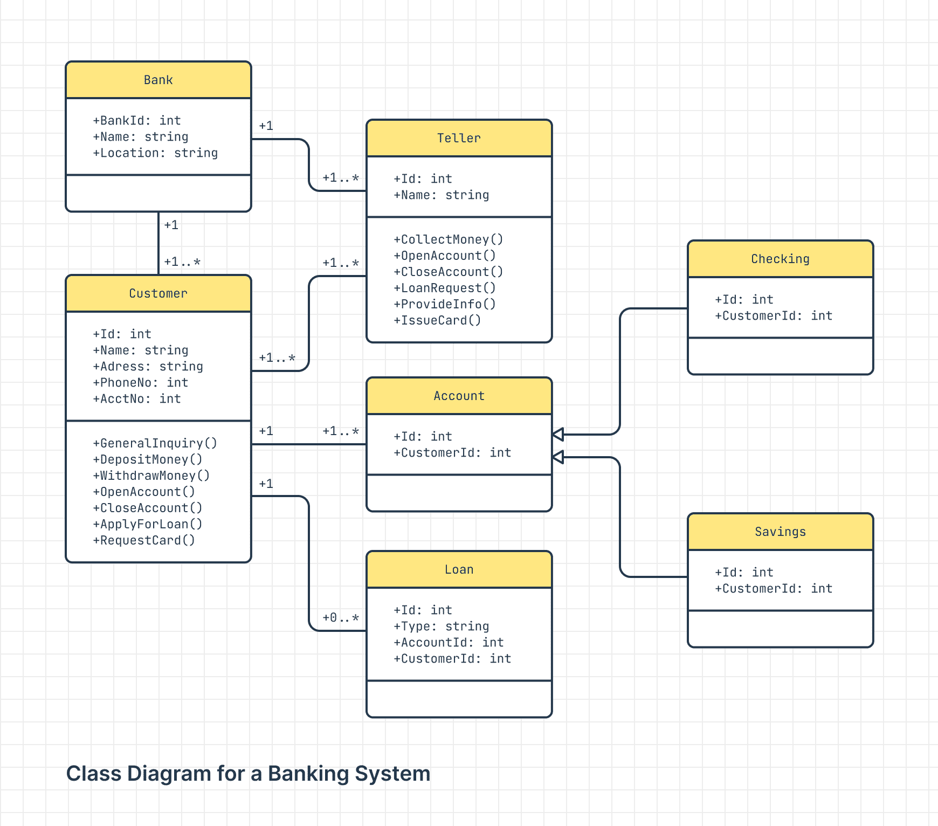
UML DIAGRAMS
Time for another type of diagram!
Unified Modelling Language (UML) Diagrams – series of diagrams used to map out classes in Object-Oriented Programming

Slide 28
UML DIAGRAMS
For today, let’s just look at how to make one class in UML
The BankAccount class

Slide 29
UML DIAGRAMS
What data are we keeping track of for each account?
What functions are we calling on each account?

Slide 30
UML DIAGRAMS
Great!
Data: Name, balance
Functions: BankAccount, deposit, withdraw, transfer
In a UML diagram, we put
The name on the top row
The data/variables on the second row
The functions on the bottom row
Let’s look at a template

Slide 31
UML DIAGRAMS
So how would this look for our bank account?
ClassName
variable: type variable: type variable: type
+ function(parameter type(s)): return type + function(parameter type(s)): return type + function(parameter type(s)): return type

Slide 32
UML DIAGRAMS
So how would this look for our bank account?
BankAccount doesn’t have a return type because it is a constructor
More on that later
Void means that the function doesn’t return any data type, it simply modifies the data within
BankAccount
Name: string Balance: float
+ __init__(name) + deposit(float): void + withdraw(float): void + transfer(float, BankAccount): void

Slide 33
OOP LAB 1
Create UML diagrams for the following classes
Car
Variables: Miles, Model, Color
Functions: Drive, Paint
Thermostat
Variables: CurrentTemp, DesiredTemp
Functions: UpdateTemp

Slide 34

VOCABULARY TO REMEMBER
Object-oriented Programming
Class
Object
UML Diagram

